Slide 1

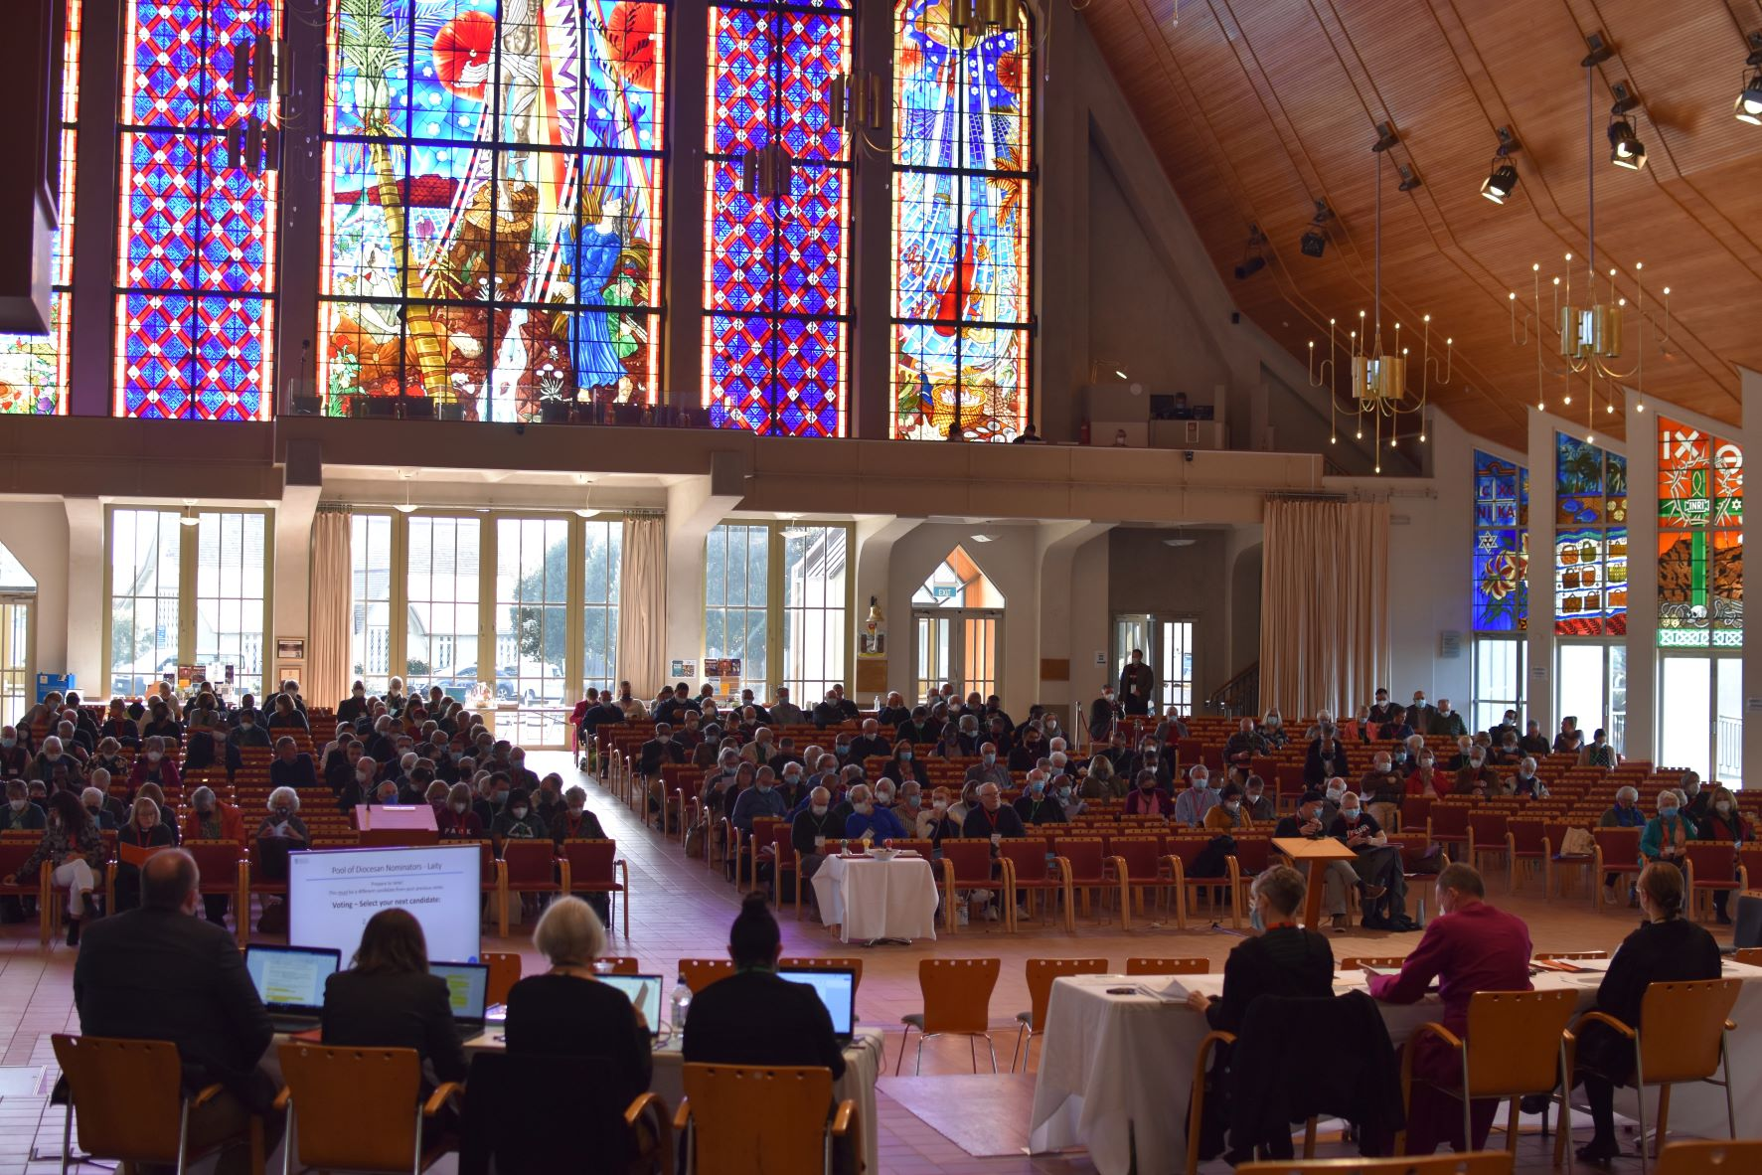
Synod 2022
Thursday 1 September 6.30pm to Friday 2 September 5.45pm

Slide 2
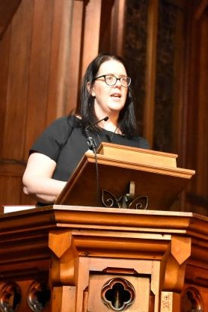
Eucharist Service
Sermon:
Helen Robinson, City Missioner-Manutaki, Auckland City Mission
HomeGround – not just a building but a place for all
Special tribute to Bishop Jim White – 17 years on the Mission’s Board.

Slide 3
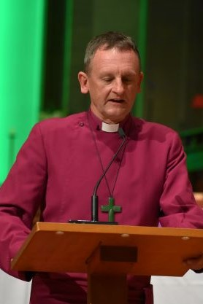
Bishop’s Charge
Impact of COVID-19
Report on Lambeth Conference
Renewed focus on ministry formation and growth in vocations
Selwyn Foundation and City Mission developments
Participation in the work of the Royal Commission of Inquiry into Abuse in Care
QC report on Ross Browne
Apology to those failed by the Church and its institutions.

Slide 4
Synod Business
Two small-group conferences
The Maintenance Challenge
What is the primary challenge relating to the care of our buildings?
How should we fund ongoing maintenance?
2. The Structure of Synod
What are the barriers/challenges to Synod’s effectiveness?
If Synod is restructured what elements should be retained?
What aspects of our diversity should be considered?

Slide 5
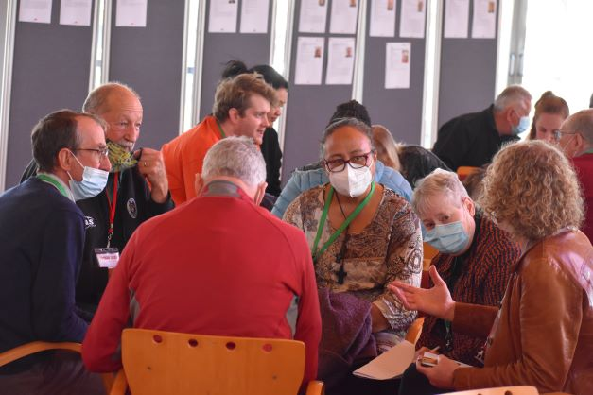
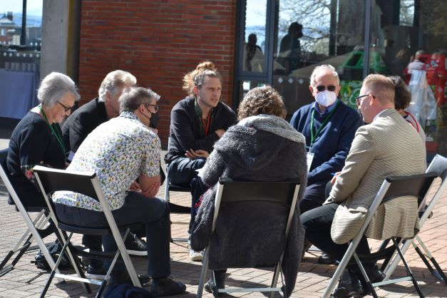
Small-group conferences

Slide 6
Motions
Motion 2 – Synod review
Asks Diocesan Council to set up a working group
Working group to review the structures of Synod to best serve the future governance needs of the diocese.
Motion 3 – Three Tikanga structure
It is more than 30 years since the three-tikanga structure was established, including Māori, Pākehā and Pasefika.
Synod requests a review of the structure by General Synod Te Hīnota Whānui
A caveat from the Bishop that this should not be decided by Tikanga Pākehā alone.

Slide 7
Motions
Motion 4 – Our urban ngahere (forests)
Synod affirms the crucial role of trees and plants
All Anglicans are urged to promote protection of and education about trees and other plants
Ministry units are encouraged to explore ways to enhance native biodiversity.
Motion 5 – Intergenerational opportunities
Asks ministry units and Anglican partners to explore ways to include children and young people in the ministry of the Church
Commends the work of the new diocesan Ministry Formation Team.

Slide 8
Motions
Motion 6 – Ministry unit property
Asks Diocesan Council to set up a working group
Working group to undertake a long-term strategic review of the physical resources of the diocese and the best physical and funding structures to deliver the mission of the Church into the future.
Motion 7 – Centralised accounting services
Asks Diocesan Council to initiate an independent review of Trust Management Limited’s centralised accounting service to the diocese, including processes and performance.

Slide 9
Motions
Motion 8 – Early school leaving because of family poverty
Calls on the New Zealand Government to:
fund initiatives to keep students engaged in school
provide an income-tested tax credit for families with 15- to 18-year-olds in education.
This motion was forwarded to Diocesan Council for consideration because time ran out at Synod to discuss it.

Slide 10
Elections
Electronic elections were held for:
Diocesan Council
Clergy Remuneration and Retirement Committee
The Pool of Potential Diocesan Nominators

Slide 11
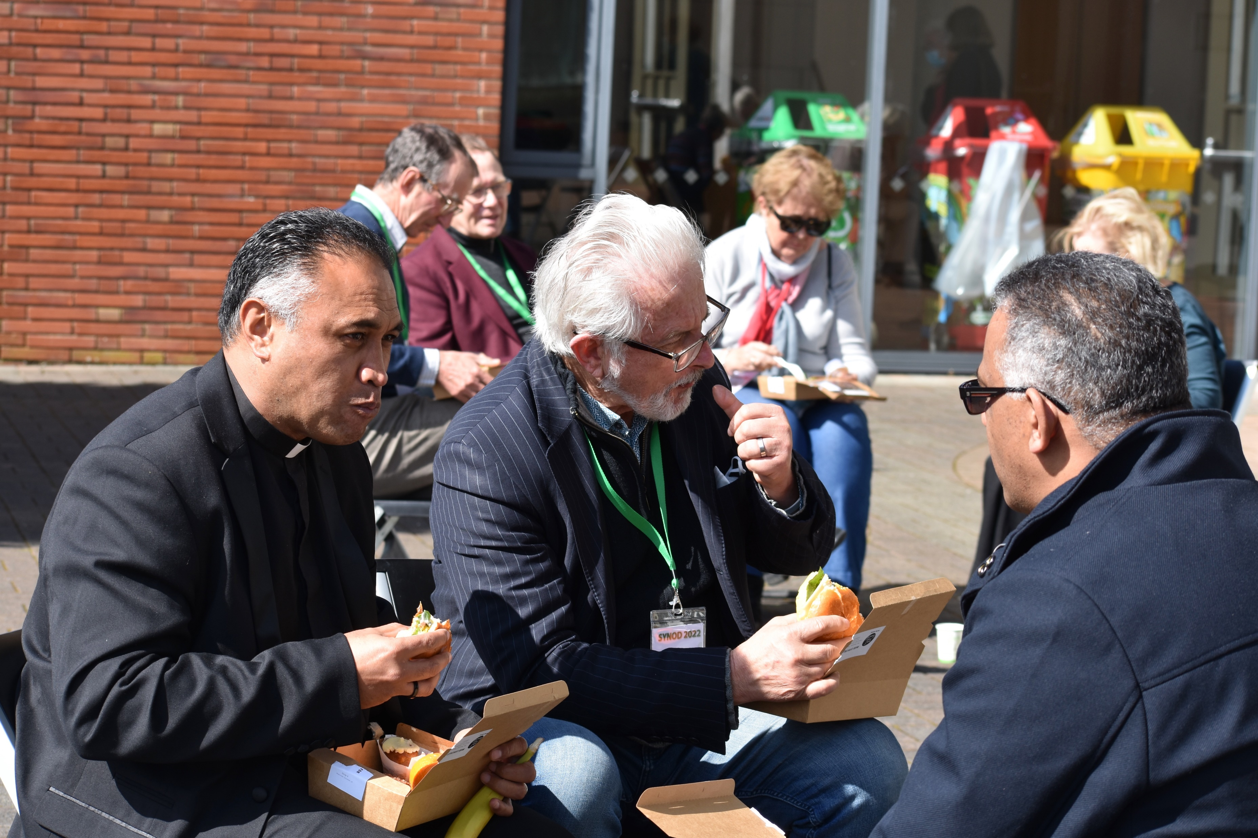
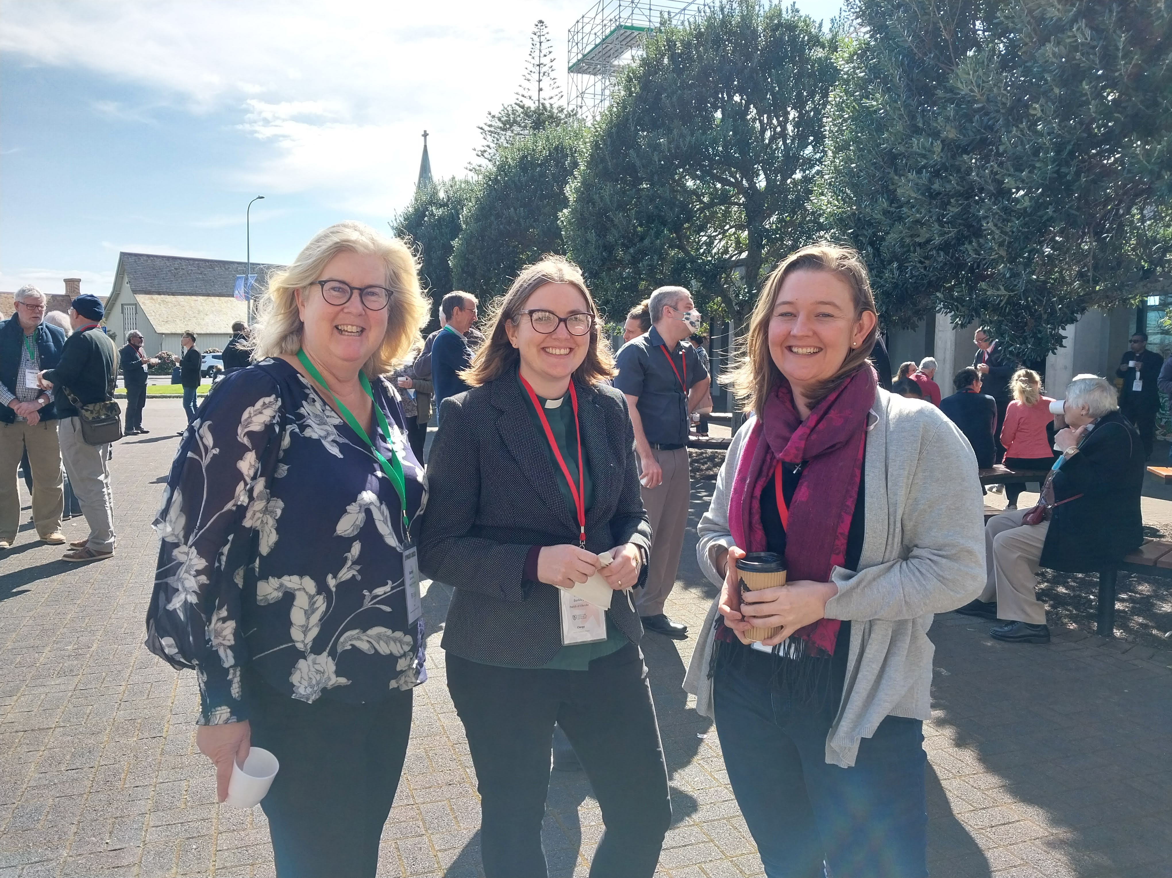
Mealtimes and breaks

Slide 12
For more …
See the Auckland Diocese website
www.aucklandanglican.org.nz
Synod 2023
will start at 6.30pm on Thursday 7 September 2023

